Slide 1
Introduction to Computer Programming Lecture 4.1:
Functions in Python
Hemma Philamore
Department of Engineering Mathematics

Slide 2

Functions
Functions are blocks of code that can be reused throughout your program.
input
output
numbers, strings,
variables,
data structures, etc.
function
number, string,
variable,
data structure, etc.
square
5
25
find max
[1, 41, 34, 5]
41

Slide 3

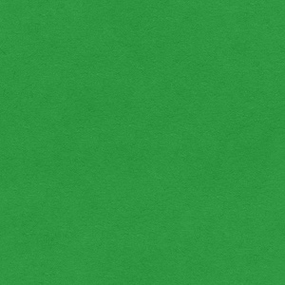
Functions
Functions often lead to cleaner code that is easier to understand and maintain.
Code is typically shorter/smaller and more reusable.
Some code
Some code
function def.
Some code
function def.
call function
Some code
Some code
call other
function
Some code
Some code
Functions have to be defined before called!

Slide 4
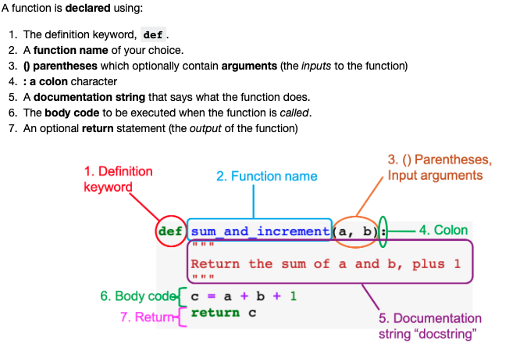
Function definition checklist

Slide 5
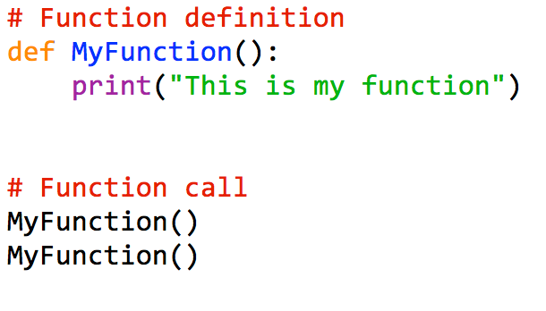
Function Example
This is my function
This is my function

Slide 6

Functions
You already know a number of predefined functions such as
print(…)
len(…)
type(…)
sqrt(…)
etc.
argument
argument

Slide 7
Function definition checklist:
return
The results can be returned in a variable

Slide 8
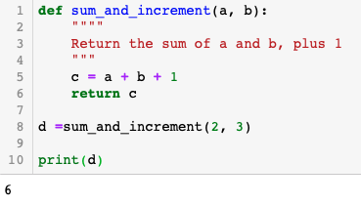
Function Example

Slide 9
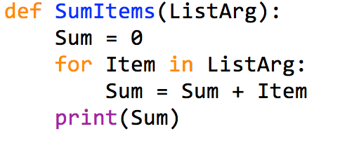
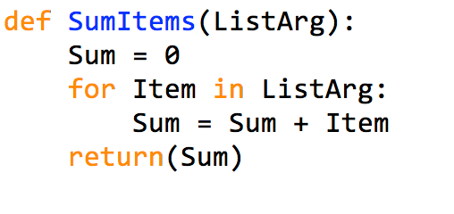
Return Statements
The results can be returned in a variable
ListArg = [1, 2, 3]
SumItems([1,2,3])
print(MySum)
6
6
print(MySum * 2)
12

Slide 10
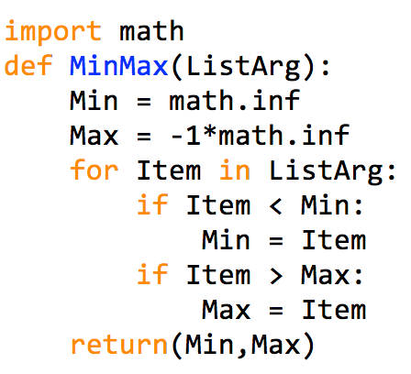
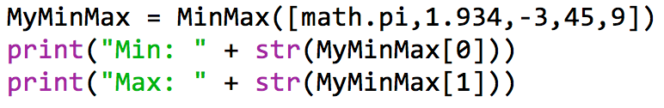
Return Statements
If you return more values, Python converts into a tuple.
Python returns
here a tuple
with 2 element
This is variable
is a tuple
individual values
can be accessed

Slide 11
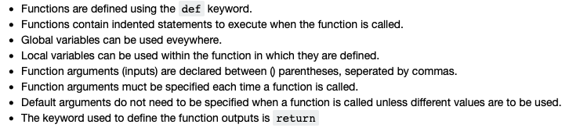
Summary
Notes:
Chop off end of video, summary not needed

